Slide 1





Simple Serverless Application
Amazon CloudWatch
Application sends
notification to
SNS Topic
Amazon SNS
Amazon SQS
AWS Lambda
Lambda polls SQS

Slide 2
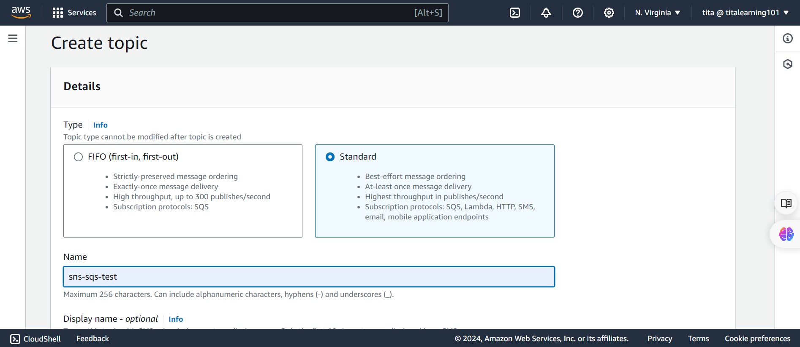
SNS Setup

Slide 3
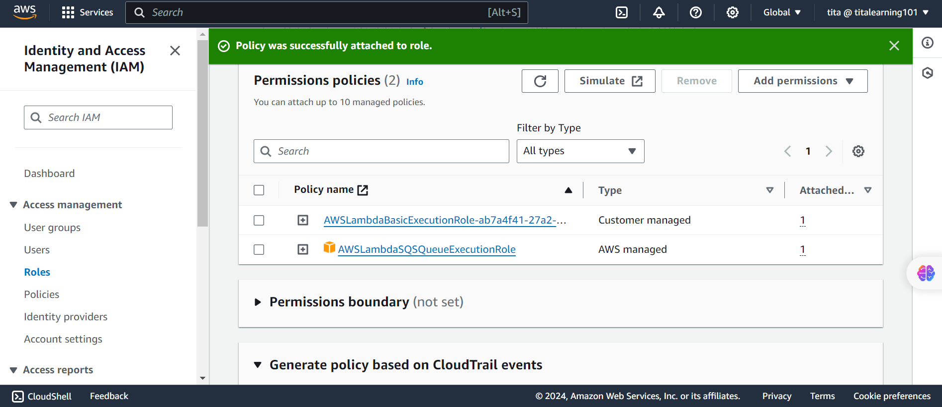
Lambda IAM Rules

Slide 4
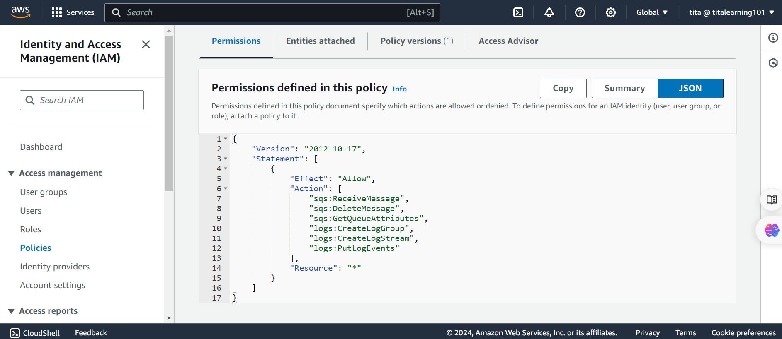

Slide 5
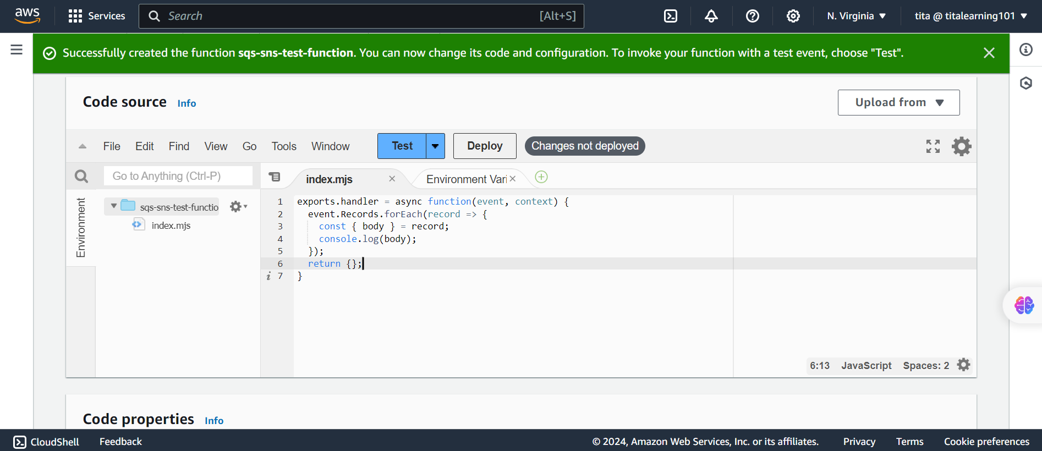
exports.handler = async function(event, context) {
event.Records.forEach(record => { const { body } = record; console.log(body);
});
return {};
}

Slide 6
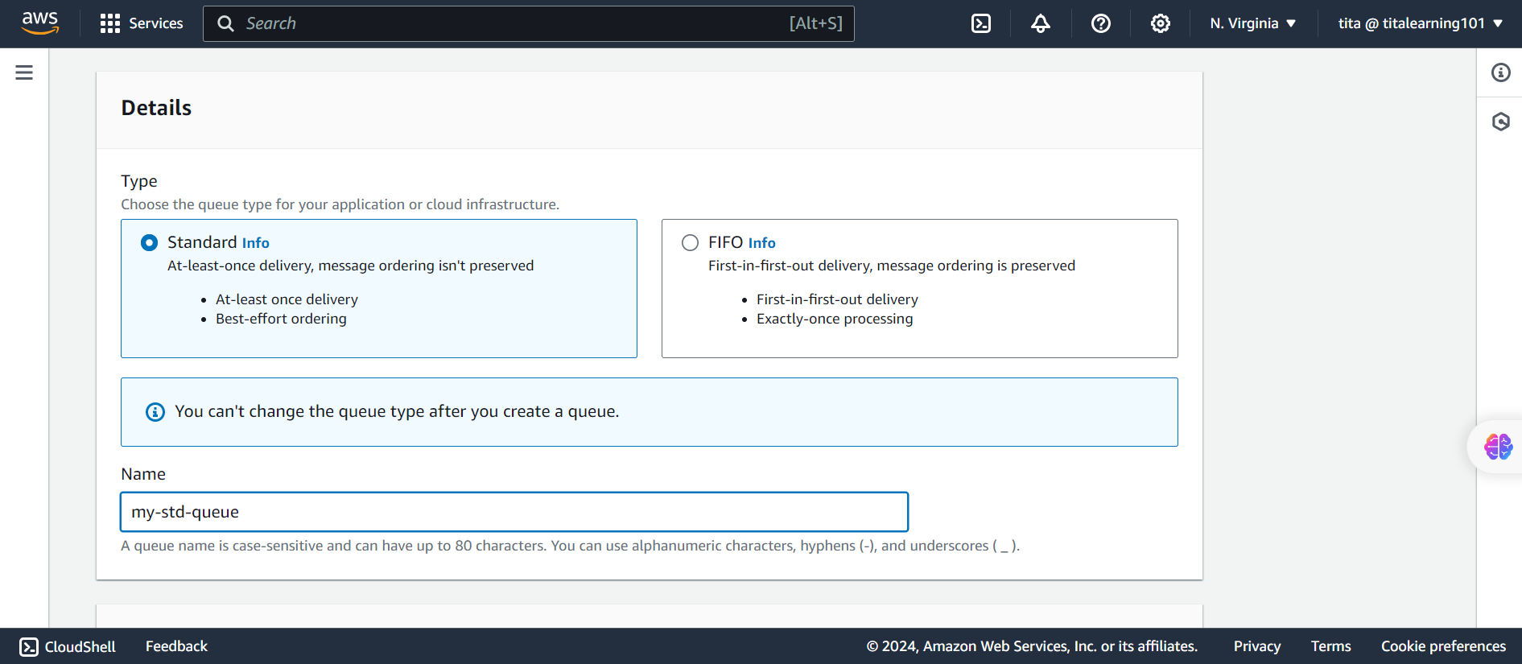
SQS Setup

Slide 7
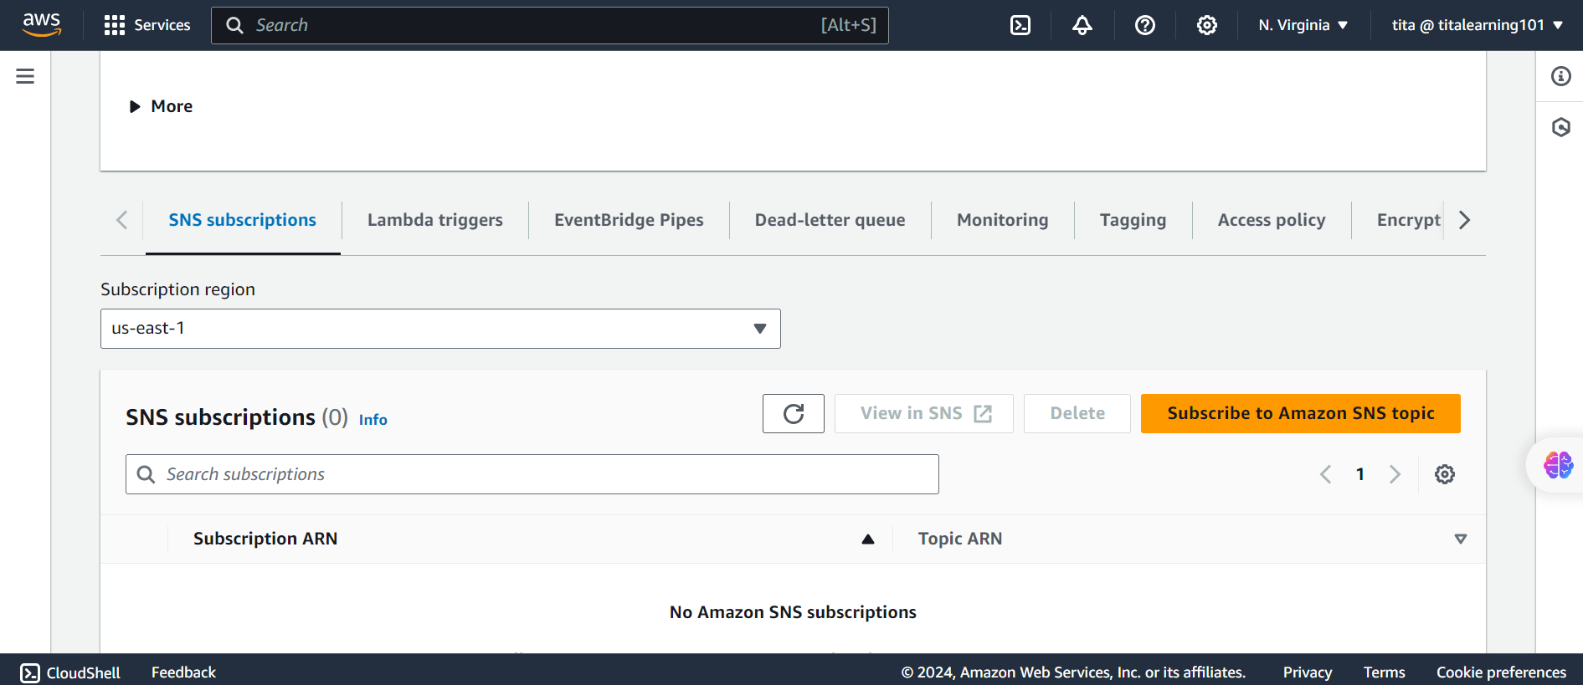
SQS Setup

Slide 8
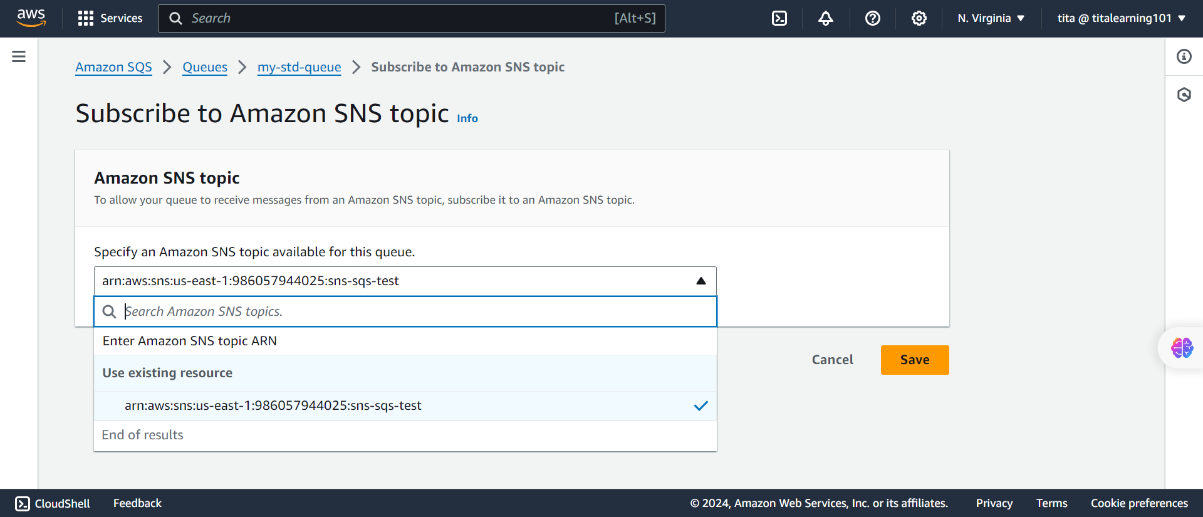
SNS Setup on AWS SQS

Slide 9
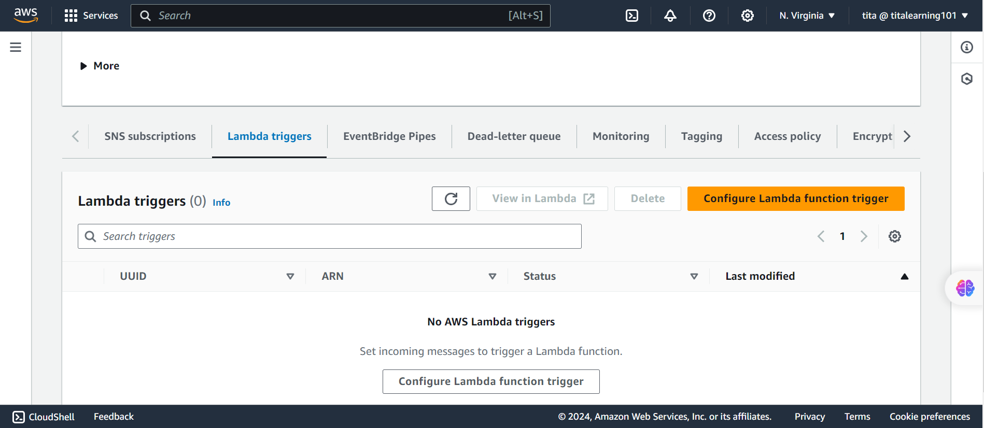
Lambda Setup on AWS SQS

Slide 10
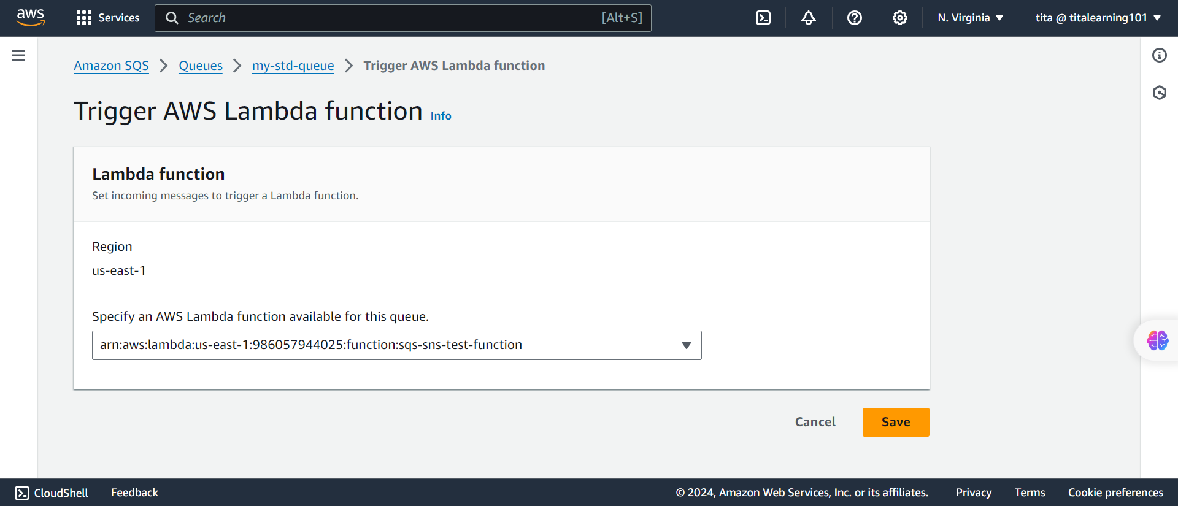
Lambda Setup on AWS SQS

Slide 11
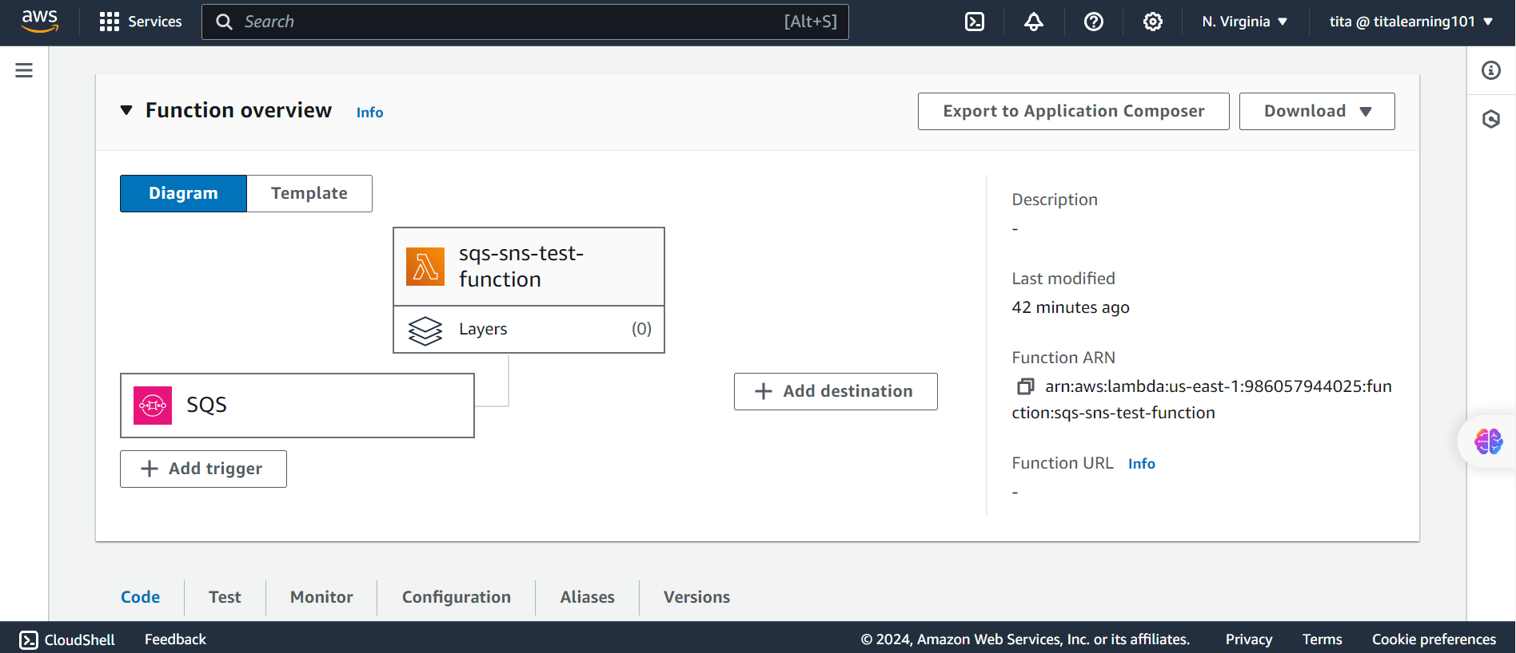
Lambda

Slide 12
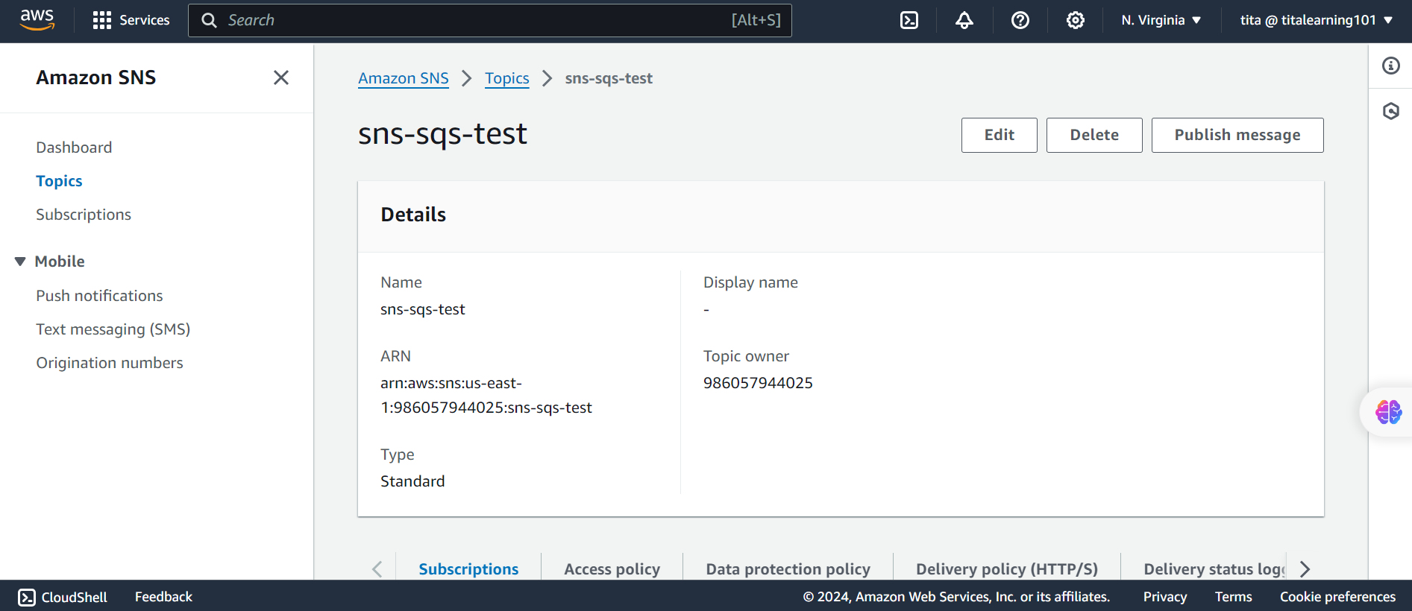
Publish Message on AWS SNS

Slide 13
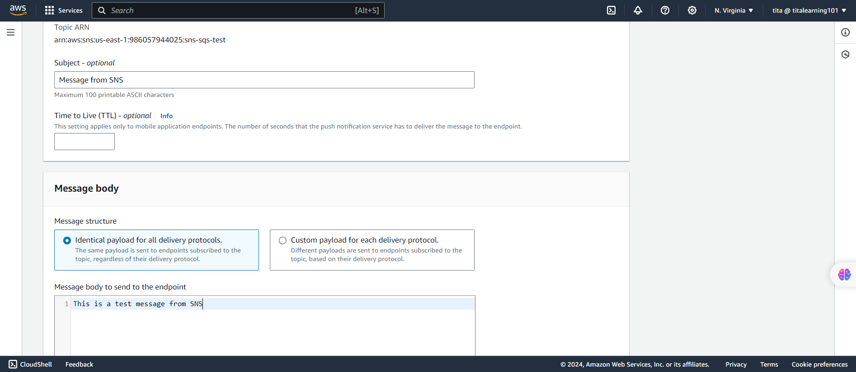

Slide 14
Message fired from SNS
Amazon CloudWatch
Application sends
notification to
SNS Topic
Amazon SNS
Amazon SQS
AWS Lambda
Lambda polls SQS

Slide 15
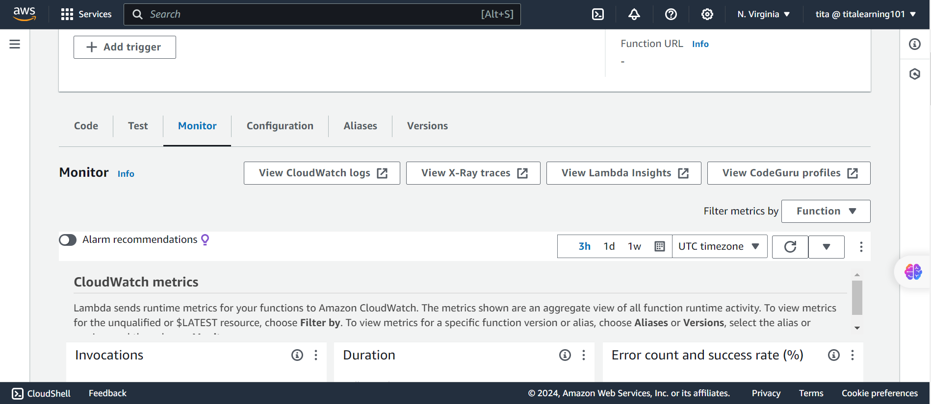
Cloudwatch

Slide 16
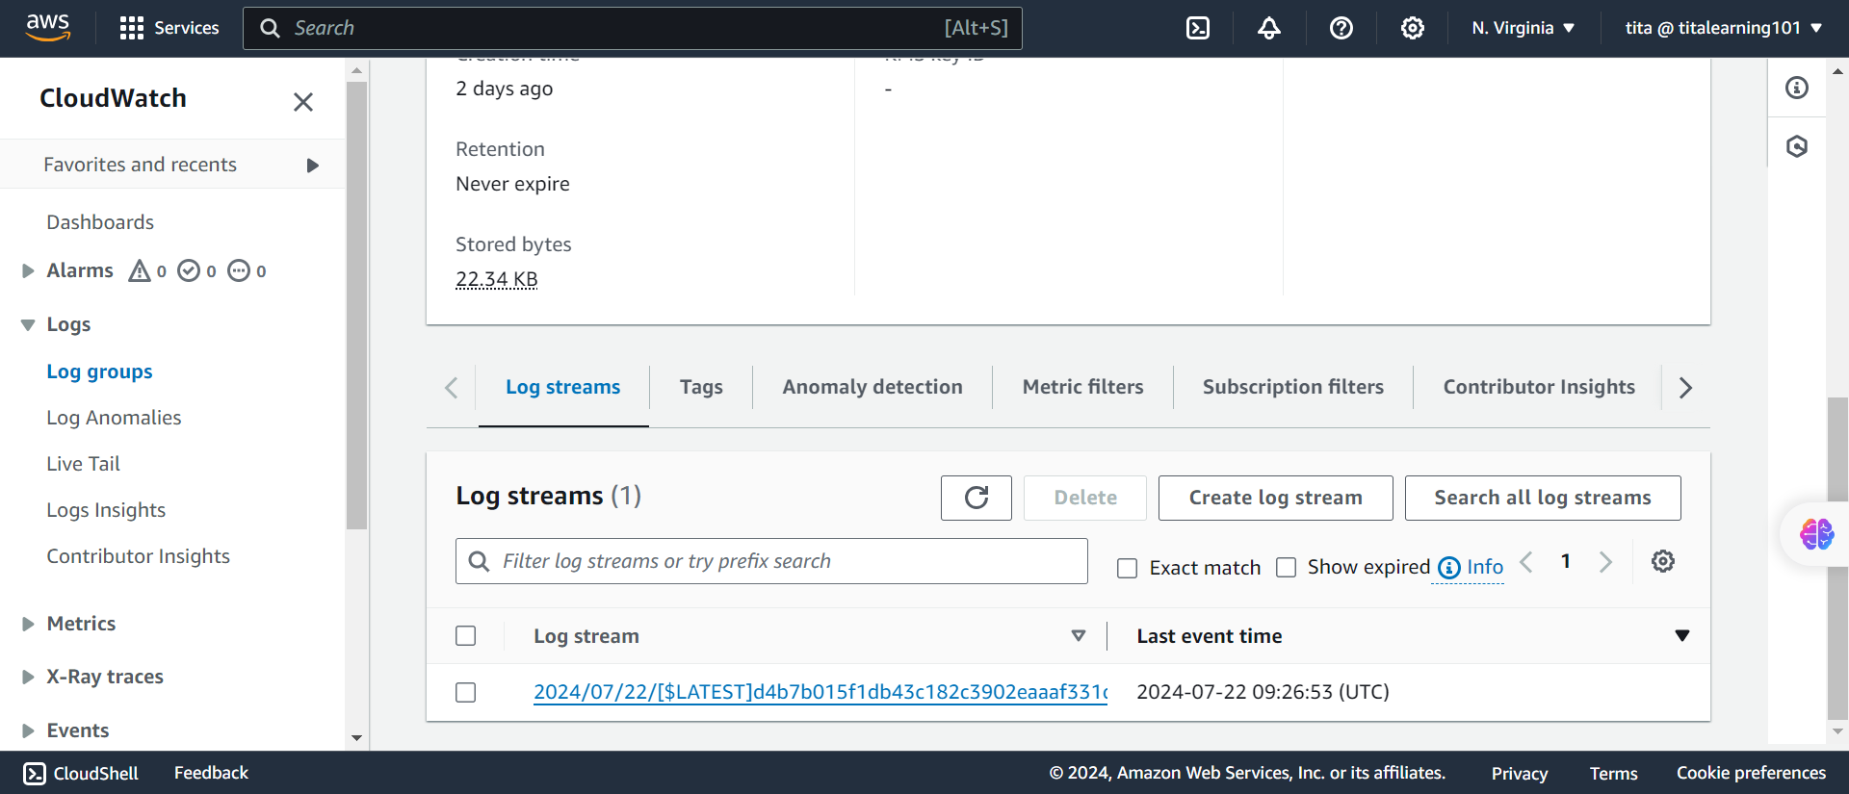
Cloudwatch

Slide 17
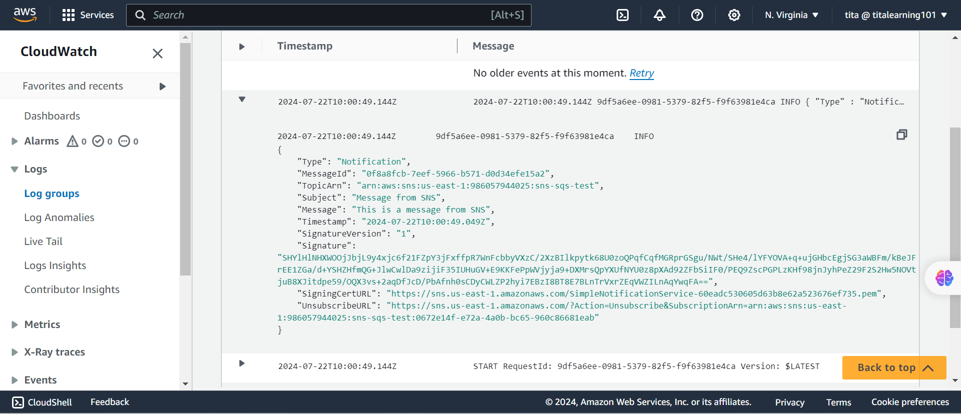
Cloudwatch

